Slide 1
Agenda
Kubernetes Advanced
Types of Service
Deployment
Replicaset
Namespace

Slide 2
Types of Services
NodePort
LoadBalancer
ClusterIP
Expose App to external world
Round-Robin Load Balancing
Best For Local Environment
Equally distribute the load in nodes
Cloud Based Load balancing
Best For the Cloud
- Reachable within the cluster
- Connect front-end pod to backend pod

Slide 3
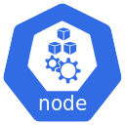
NodePort Service
apiVersion: v1
kind: Service
metadata:
name: my-service
spec:
selector:
name: my-app
ports:
- port: 80
nodePort: 30008
type: NodePort
NodePort
Service
Port
30008
80
TargetPort
Range: 30000-32767
80
Pod
container

Slide 4
LoadBalancer Service
apiVersion: v1
kind: Service
metadata:
name: aspnet-service
spec:
selector:
app: aspnet-pod
ports:
- port: 3080
targetPort: 80
type: LoadBalancer

Slide 5
Deployments
Represent a set of multiple and identical Pods .
A deployment is responsible for keeping a set of pods running.
A deployment can be used without a service to keep a set of identical pods running in the Kubernetes cluster.
Without service, Each pod could be accessed individually via direct network requests (rather than abstracting them behind a service).
Services and Deployments can work together.

Slide 6
Namespace Commands
apiVersion: v1
kind: Namespace
metadata:
name: dev
> kubectl apply –f dev-namespace.yaml
> Kubectl get namespaces
> kubectl apply –f my-pod.yaml --namespace=dev
> kubectl get pods --namespace=dev
> kubectl get pods --namespace=dev
> kubectl get pods --all-namespaces
> kubectl config set-context $(kubectl config current-context) --namespace=dev

Slide 7
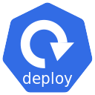

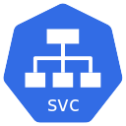
Namespace - Isolation
kube-system
default
public
dev
prod

Slide 8
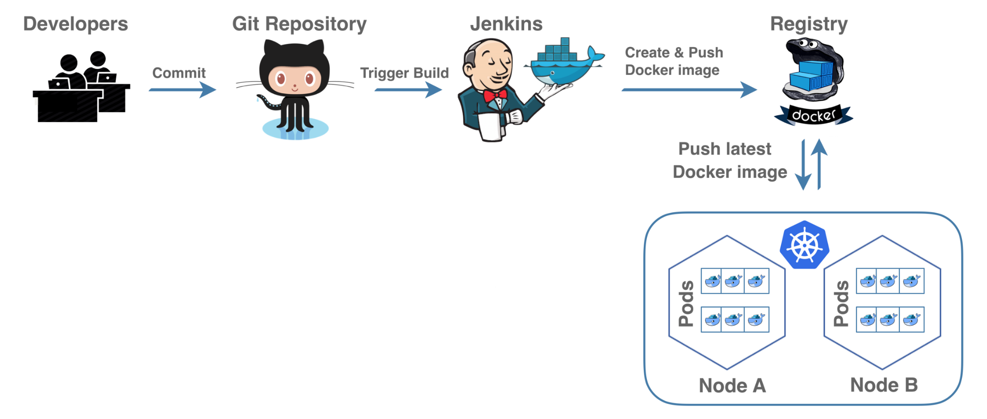
CI/CD Pipeline

